Slide 1
TITIAN
(1488/90-1576)
History of Western Art
BFA-II (Visual Arts)
Course Incharge: Ms. Farah Khan
Institute of Design & Visual Arts (LCWU)

Slide 2
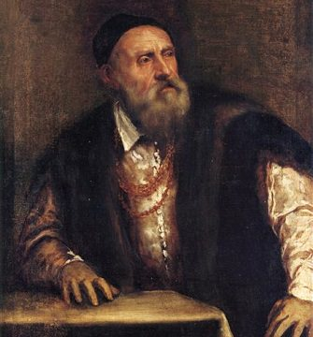
Self Portrait
The Italian painter Titian (c. 1488/90-1576) was a great master of religious art, a portraitist in demand all over Europe, and the creator of mythological compositions which for inventiveness and decorative beauty have never been surpassed.

Slide 3
Not every painter has a gift for painting, in fact, many painters are disappointed when they meet with difficulties in art. Painting done under pressure by artists without the necessary talent can only give rise to formlessness, as painting is a profession that requires peace of mind. The painter must always seek the essence of things, always represent the essential characteristics and emotions of the person he is painting.
(Titian)

Slide 4
TITIAN
Tiziano Vecellio, known as Titian was an Italian painter, the most important member of the 16th-century Venetian school. He was born in Pieve di Cadore, a small village in the Alps, the son of Gregorio Vecellio, a wealthy councilor and captain of the Venetian militia in the region. The exact date of his birth is uncertain, however, modern scholars usually set it between 1488 and 1490.
He was recognized by his contemporaries as “The Sun Amidst Small Stars” (recalling the famous final line of Dante’s Paradiso), Titian was one of the most versatile of Italian painters, equally adept with portraits, landscape backgrounds, and mythological and religious subjects. His painting methods, particularly in the application and use of color, would exercise a profound influence not only on painters of the Italian Renaissance, but on future generations of Western art.
At around the age of ten, he moved to Venice with his elder brother Francesco to take an apprenticeship as a artist. He initially studied mosaic at Sebastiano Zuccato’s workshop and was later apprenticed to Gentile Bellini. After Gentile’s death, Titian went to work for his brother Giovanni Bellini, one of the most important painters in Venice at the time. Here he met Giorgione, a previous apprentice of Bellini’s, who helped Titian develop his early style.
With Giorgione, latter he collaborated for work, which was influential for his tonal approach to painting and for his landscape style, which was atmospheric and evocative. The two artists worked in such a similar manner that the line between them has been hard to fix.

Slide 5
TITIAN
Titian was one of the greatest Renaissance painters who is thought to be responsible for combining High Renaissance and Mannerist ideas for the development of a style ahead of his time.
He was a master of portraiture and dominated Venetian art with his creative abilities. Besides portraiture he also painted a range of religious and mythological subjects, sometimes on a vast scale.
During a long and prolific career his work developed from traditional Renaissance imagery to increasingly energetic canvases which rejected balanced compositions and replaced them with asymmetry and dynamic subjects. Towards the end of his life, his work became darker and more impressionistic. He had a huge impact on his contemporaries and his canvases can be seen as forerunners of the emotional drama of Baroque art as well as influencing later innovators.
He is known as a colorist not a draftsman. During the course of his long life, Titian’s artistic manner changed drastically but he retained a lifelong interest in color. Although his mature works may not contain the vivid, luminous tints of his early pieces, their loose brushwork and subtlety of tone are without precedent in the history of Western painting.
Titian is known above all for his remarkable use of color; his painterly approach was highly influential well into the seventeenth century. Titian contributed to all of the major areas of Renaissance art, painting altarpieces, portraits, mythologies and pastoral landscapes with figures.

Slide 6
Characteristic Features
Titian’s bold application of color made him legendary, primarily in his earlier work which was achieved by him through seeking out rare pigments which were then utilized in their richest and most saturated form. Not only this, he carefully balanced each color to create a harmonious overall impression.
He also focused on the effect of light on color application lighting effects, including chiaroscuro, to emphasize contrasting hues. Through this focus he created the distinction between Venetian and Florentine art, Renaissance artists in Florence and Rome believed that line was paramount (the principal feature), whereas the Venetian Renaissance style was defined by color and led by Titian.
“A good painter needs only three colors: black, white and red” said by Titian.
His style and bold application of colors left significant influence on the three most influential post-Renaissance artists, namely Velazquez, Rubens and Rembrandt.
The artist’s later work is characterized by loose brush strokes and an expressive application of paint and it is likely that, at times, he used his fingers as well as brushes to apply and blend paint. While painting in this manner, Titian created a fluidity that lent a greater sense of movement and emotion to his work and was unique amongst his peers.

Slide 7
Characteristic Features
Titian worked almost exclusively in oil, which was a new technique at the start of his career. The medium allowed him to build up a series of glazes to depict the appearance and texture of the human form with an accuracy, delicacy, and softness which was innovative.
In 1590 the art theorist Giovanni Lomazzo called Titian, “the sun amidst small stars not only among the Italians but all the painters of the world” and masters such as Rubens, Rembrandt, and Tintoretto show a debt to Titian in terms of composition, color and use of looser brushstrokes. This influence extended well into the seventeenth century with Marco Boschini writing in 1674, nearly a hundred years after Titian's death, that:
“Titian truly was the most excellent of those who painted: because his brushes always gave birth to expressions of life”.
His religious compositions cover the full range of emotion from the charm of his youthful Madonnas to the tragic depths of the late Crucifixion and the Entombment.

Slide 8
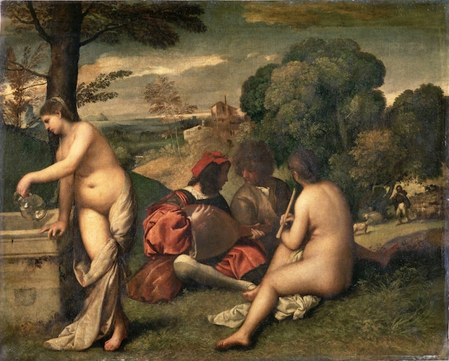
Pastoral Concert (1509)

Slide 9
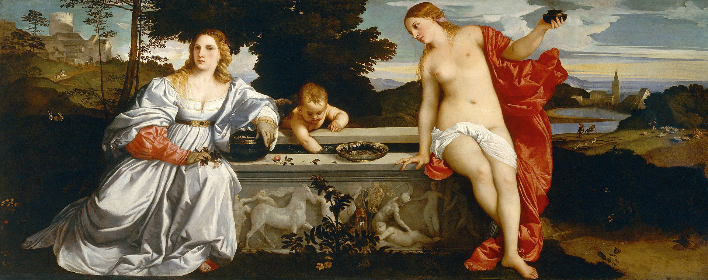
Sacred and Profane Love (1514)

Slide 10
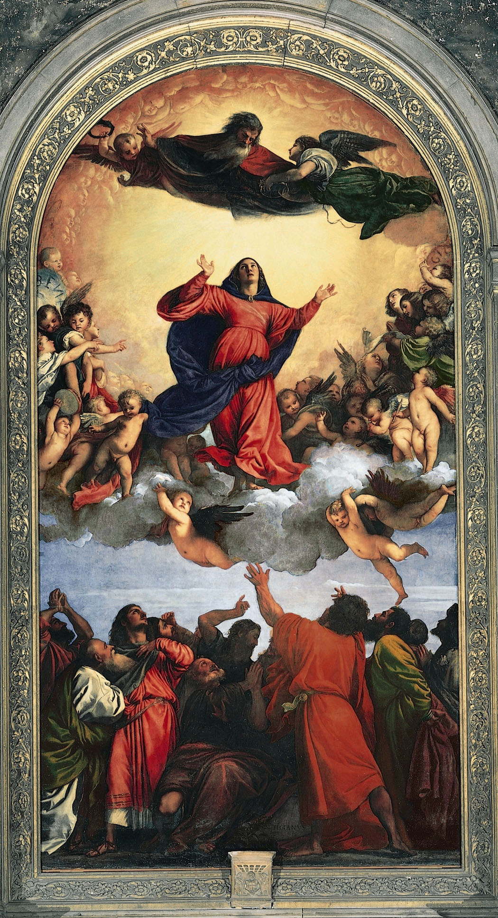
The Assumption of the Virgin (1516-1518)
Titian’s first major public commission in Venice, the Assumption of the Virgin
for the high altar of Santa Maria Gloriosa dei Frari (1516–18), established his place as the leading painter of the city. Contemporaries noted that some viewers were uneasy with its novel portrayal of the dynamically twisting Virgin and the gesticulating apostles below. It broke with tradition as well in the heroic scale of the figures and the use of bold color. The Assumption can be seen from the far end of the church, drawing the eye to the sacred space of the altar.

Slide 11
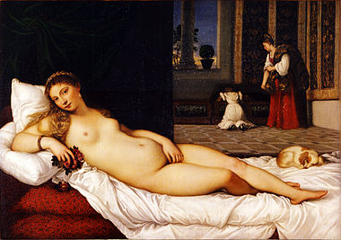
Venus of Urbino (1534)
Venus, the mythological goddess of love, is the protagonist of a number of works by Titian, the best known probably being the so-called ’Venus of Urbino’
(Galleria degli Uffizi, Florence). Painted for Francesco Maria I della Rovere’s private chambers, this reclining nude
is at once idealized and erotic.

Slide 12
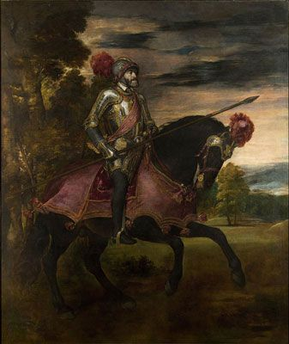
Portrait of Charles V at Horseback (1548)

Slide 13
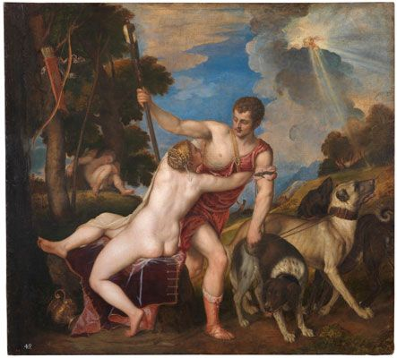
Venus and Adonis (1554)

Slide 14
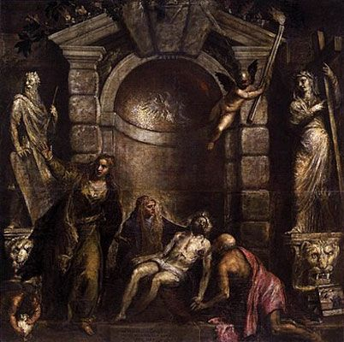
Pieta (1575-76)

Slide 15
“Art is Stronger than Nature”
(Titian)

